Slide 1

POWER
Presentation by
K.RAJAIAH
Notes:
PHYSICS

Slide 2
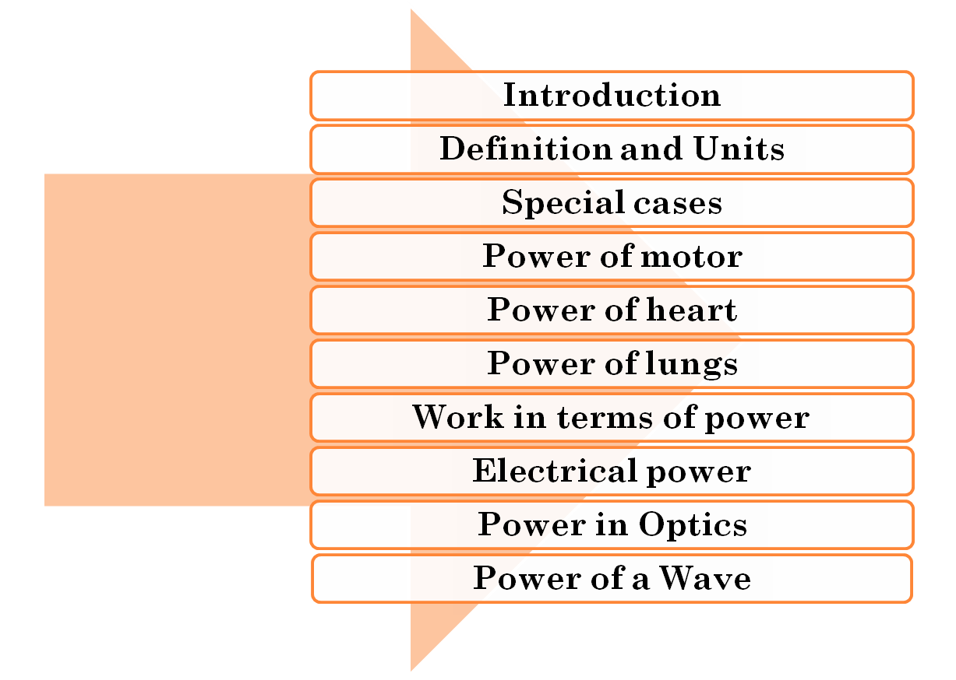


AGENDA

Slide 3


INTRODUCTION
WORK : The work done by the the force is defined to be the product of component of the force in the direction of the displacement and the magnitude of this displacement. Thus
Often it is interesting to know not only the work done on an object, but also the rate at which this work is done.
For example, a person takes an abnormally long time to
elevate his body up a few meters along side of a cliff.
On the other hand another person might elevate his body
in a short amount of time.
The two persons might do the same amount of
work but the second person does the work in less
time than the first person.
RGUIIIT BASAR

Slide 4


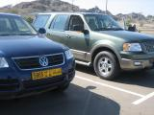

Example 2
Imagine two cars of same mass but different engines. Both the cars climb roadway up a hill. But one car takes less time where as another one takes more time to reach the top. So it is very interesting to know not only the work done by the vehicles but also the rate at which it is done.
RGUIIIT BASAR

Slide 5

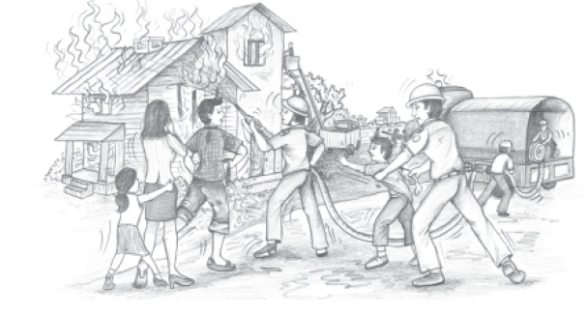
Example 3
To extinguish the fire in a building water is to be lifted up and sprayed on the fire as fast as possible. The fastness will be depend on the motor used to lift the water i.e, at what rate it is lifting the water( or doing the work).
RGUIIIT BASAR

Slide 6




DEFINITION
POWER:- The rate of doing work is called as power.
or
The rate at which work is done or energy is
transferred is called as power.
Like work and energy, power is a scalar quantity.

Slide 7

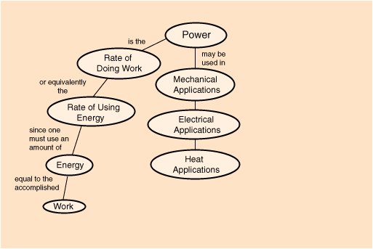

DEFINITION & APPLICATIONS

Slide 8


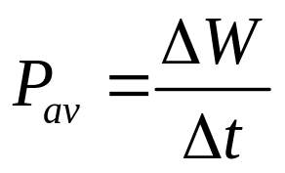
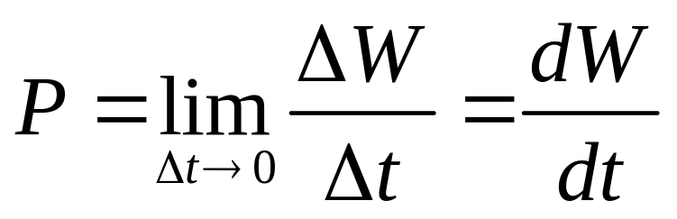

AVERAGE AND INSTANTANEOUS POWER
When a quantity of work is done during a time interval
, the average work done per unit time or average power is defined to be
We can define the instantaneous power as the limiting value of the average power as approaches to zero.

Slide 9



UNITS OF POWER
C.G.S System erg/sec
M.K.S System joule/sec (or) kg m² s⁻³ (or) watt
In the British system, work is expressed in foot-pounds, and the unit of power is the foot-pound per second. A larger unit called the horsepower (hp) is also used:
1 hp = 550 ft.lb/s = 33,000 ft.lb/min
That is, a 1-hp motor running at full load does 33,000 ft-lb of work every minute. A conversion factor is
1 hp = 746 W = 0.746 kW
That is, 1 horsepower equals about ¾ of a kilowatt.

Slide 10

UNITS OF POWER
The watt is a familiar unit of electrical power; a 100-W light bulb converts 100 J of electrical energy into light and heat each second.
The units of power can be used to define new units of work and energy. The kilowatt-hour (kWh) is the usual commercial unit of electrical energy. One kilowatt-hour is the total work done in 1 hour (3600 s) when the power is 1 kilowatt (10³ J/s), so
1 kWh = (10³ J/s) (3600 s) = = 3.6 MJ
The kilowatt-hour is a unit of work or energy, not power.
Our electricity bills carry the energy consumption in units of
kWh.
The dimension formula for power is given by
ML²T⁻³

Slide 11
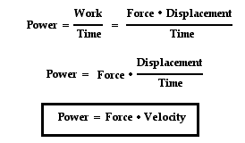

ALTERNATIVE FORMULAE FOR POWER
Thus the power associated with force F is given by
P = F .v
where v is the velocity of the object on which the force acts. Thus
P = F . v = Fvcos
__
__
__
__
__

Slide 12




SPECIAL CASES
Power = work/time = Energy/time =P.E/time = K.E/time
= (mgh)/t = (1/2mv²)/t
If a gun fires ‘n’ bullets each of mass ‘m’ with a velocity ‘v’ in ‘t’ seconds, the power of the gun is given by
P = n(1/2mv²)/t

Slide 13


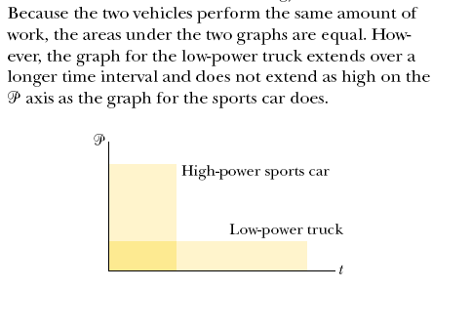
QUIZ

Slide 14




POWER OF MOTOR
The power of a motor required to lift ‘m’kg of water from a well of depth ‘h’ in time ‘t’ is given by
P = (mgh)/t (1m³ = 1000kg)
If the efficiency of the motor is ‘x%’ then
P = (100/x)(mgh)/t

Slide 15
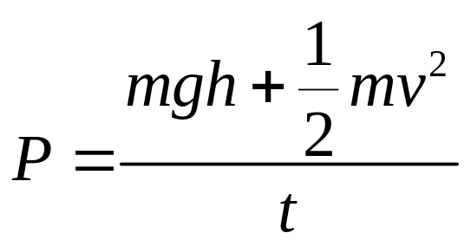

POWER OF MOTOR
If a motor lifts the water from a depth ‘h’ and delivers
them with a velocity ‘v’ in time ‘t’ then the power of the
motor is given by

Slide 16

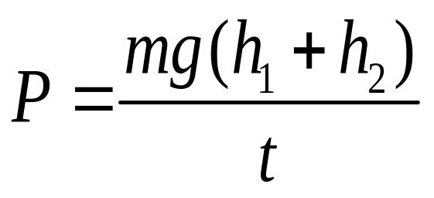
POWER OF MOTOR
If a motor lifts the water
from a depth ‘h₁’ and then
raises to a height ‘h₂’ then
the power of the motor is
given by

Slide 17

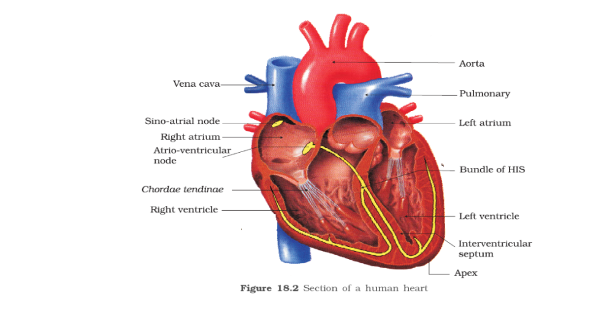

POWER OF HEART
Power of heart = work/time
= (F.s)/t
= (PxA.s)/t
= (PxV )/t
= (hdgV)/t
(P = pressure,A = area of vessel, V = volume of vessel and
s = length of the vessel)
Thus power of heart = P(V/t) = (hdgV)/t
= Pressure x volume of blood pumped per second

Slide 18
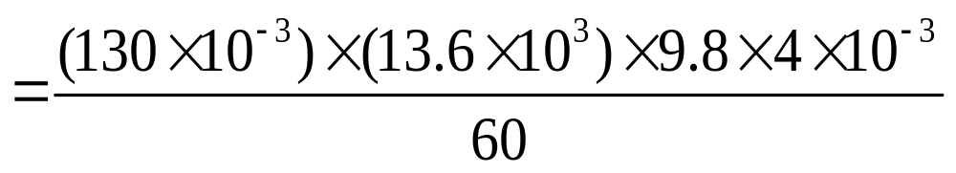
HEART PROBLEM
The heart of a man pumps 4 litres of blood per minute at a pressure of 130 m.m. of Hg. If the density of the blood is 13.6 gm/c.c. calculate the power of the heart.
Solution:-
Power of heart = (hdgV)/t
= 1.155watt.

Slide 19
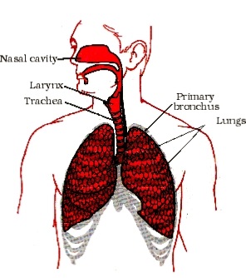
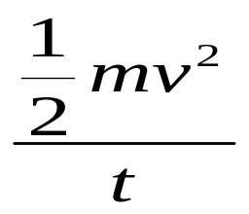
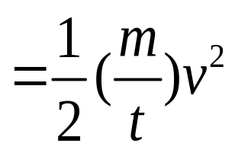

POWER OF LUNGS
Power of lungs =
(mass of air blown per second ) x (velocity)²

Slide 20

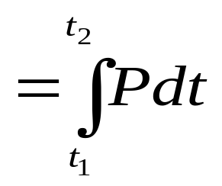
WORK IN TERMS OF POWER
The work done by from time t₁ to time t₂ is given by
Where P = F.v
W

Slide 21
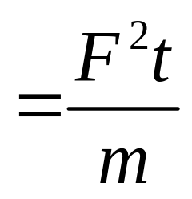
POWER
If force F acted on a body of mass ‘m’ which is at rest , then the power produced in that body in time ‘t’ is given by
P = F.v
= F(F/m)t
V = u + at
= 0 + at
= at
= (F/m)t
P
P = Fv
= mav
= ma(at)
= ma²t

Slide 22
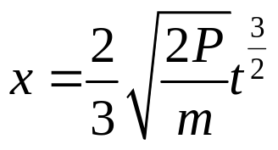
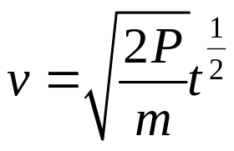
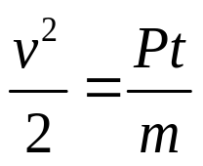
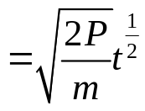
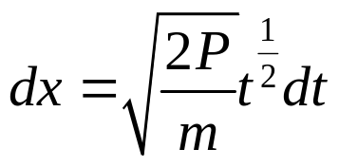
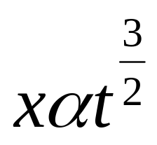
A box of mass ‘m’ moved along a straight line by a machine delivering constant power(P).Then the distance moved by the body in terms of m, P & t is given by
Solution:- P=Fv = mav
P= m(dv/dt)v
vdv = (P/m)dt ,by integrating we get
^{dx/dt}
^{On integrating we get,}

Slide 23
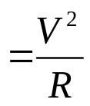
ELECTRICAL POWER
Electrical power
Instantaneous electrical power
The instantaneous electrical power P delivered to a component is given by
P(t) = V(t).I(t)
where P(t) is the instantaneous power, measured in watts (joules per second)
V(t) is the potential difference (or voltage drop) across the component, measured in volts
I(t) is the current through it, measured in amperes
If the component is a resistor, then:
P = V.I = I² .R
where R is the resistance, measured in ohms.

Slide 24
Average electrical power for sinusoidal voltages
The average power consumed by a sinusoidally-driven
linear two-terminal electrical device is a function of the
root mean square (rms) values of the voltage across the
terminals and the current through the device, and of the
phase angle between the voltage and current sinusoids.
That is,
P = V.I cosø

Slide 25
AVERAGE ELECTRICAL POWER FOR SINUSOIDAL VOLTAGES
Contd..
where
P is the average power, measured in watts
I is the root mean square value of the sinusoidal
alternating current (AC), measured in amperes
V is the root mean square value of the sinusoidal
alternating voltage, measured in volts
φ is the phase angle between the voltage and the current sine functions.

Slide 26
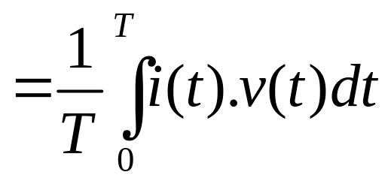


AVERAGE ELECTRICAL POWER FOR AC
Average electrical power for AC
P
Where v(t) and i(t) are, respectively, the instantaneous voltage and current as functions of time.
For purely resistive devices, the average power is equal to the product of the rms voltage and rms current, even if the waveforms are not sinusoidal. The formula works for any waveform, periodic or otherwise, that has a mean square; that is why the rms formulation is so useful.

Slide 27
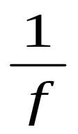
POWER IN OPTICS
Optical power
In optics, or radiometry, the term power sometimes refers to radiant flux, the average rate of energy transport by electromagnetic radiation, measured in watts.
The term "power" is also, however, used to express the ability of a lens or other optical device to focus light. It is measured in dioptres (inverse metres), and equals the inverse of the focal length of the optical device.
P = ( ‘f ‘ in metres)

Slide 28
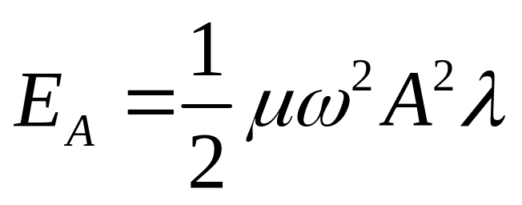


POWER OF WAVE
The total power in one wave length of the wave is given by
where = mass per unit length,
= wave length,
A = amplitude.
As the wave moves along the string, this amount of energy passes by a given point on the string during one period of the oscillation.

Slide 29
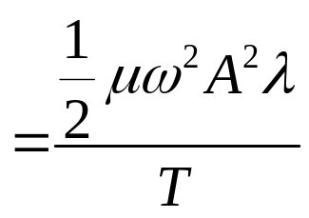
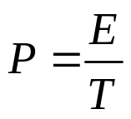
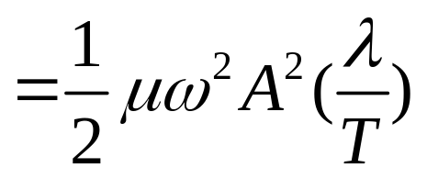
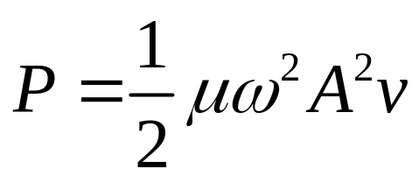


POWER OF WAVE
Contd..
Thus the power (or) rate of energy transfer associated with the wave is
Thus, P v ; P ; P A².

Slide 30
SUMMARY
The rate at which work is done or energy is transferred is called as power.
P = F . v = Fvcos
Power = work/time = Energy/time =P.E/time = K.E/time
= (mgh)/t = (1/2mv²)/t
Power of motor
Power of heart
Power of lungs
Electrical power
Optical power
Power of wave

Slide 31


By

Slide 32
This powerpoint was kindly donated to
www.worldofteaching.com
http://www.worldofteaching.com
Is home to well over a thousand powerpoints submitted by teachers. This a free site. Please visit and I hope it will help in your teaching

